Slide 1
Introduction to Remote Sensing
Stan Kidder
COMET Faculty Course
Boulder, CO
August 9, 2011
kidder@cira.colostate.edu
1

Slide 2
Introduction
In order to correctly interpret weather satellite images, or to develop algorithms to retrieve quantities from their data, one must have an idea of where the radiation sensed by the satellite originated.
For most satellite instruments of interest to forecasters, the images appear to capture radiation emitted by the surface or clouds.
However, this emitted radiation must travel through the atmosphere, where at least part of it is absorbed and where the air molecules emit their own radiation.
This is the realm of a field called radiative transfer, that is, the transfer of electromagnetic radiation through the atmosphere.
2

Slide 3
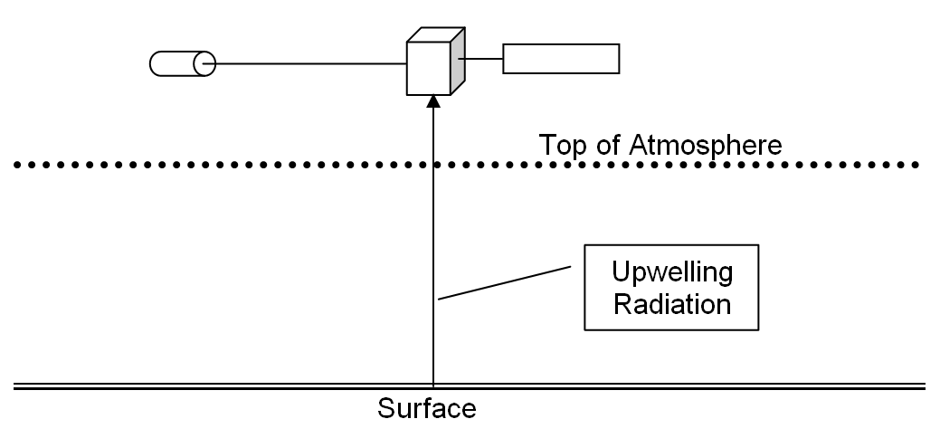
What Do Satellites Measure?
Electromagnetic radiation
That’s all, just electromagnetic radiation
3

Slide 4
Blackbody Radiation
All things emit radiation
The “perfect emitter” of radiation is called a blackbody. It emits radiation according to the Planck function:
4
Notes:
Max plank won Nobel prize for this equation

Slide 5
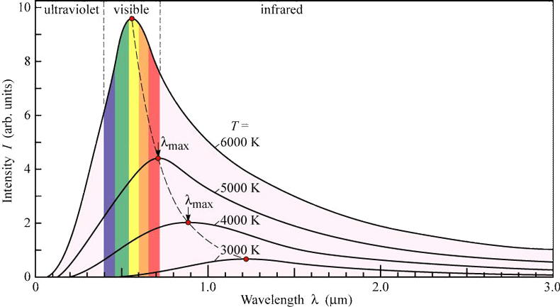
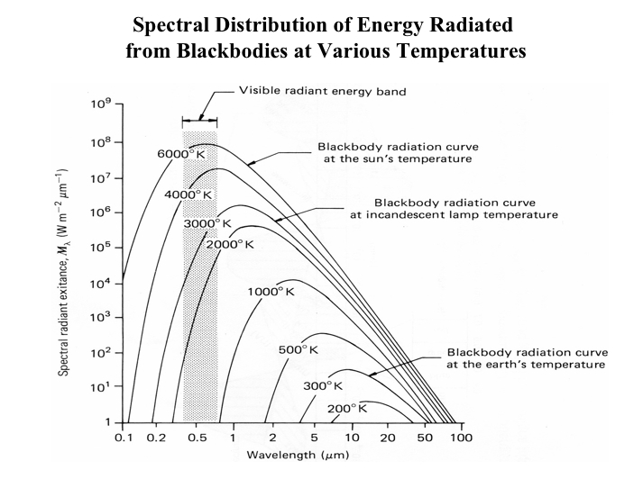
Blackbody Radiation
A hotter blackbody emits more radiation at all wavelengths than does a cooler blackbody
All blackbodies have a peak in radiation which decreases in wavelength (λ) as T increases.
Source
Source
5

Slide 6
Non-blackbodies
Real objects are less-than-perfect emitters. They emit
where 0 ≤ ε_{λ} ≤ 1
ε_{λ} is a strong function of wavelength (and the composition of the emitter).
6

Slide 7
Non-blackbodies
If a_{λ} is the fraction of radiation incident on a body that is absorbed, then
That is, a body is exactly as good an absorber as an emitter at every wavelength.
7

Slide 8
Non-blackbodies
Energy is conserved, so that radiation incident on a body is either absorbed by the body (a_{λ}), transmitted through the body (τ _{λ}), or reflected by the body (ρ_{λ}):
8

Slide 9
Non-blackbodies
In the infrared portion of the spectrum, for most surfaces, ε_{λ} is in the 0.9–1.0 range; that is, most surfaces, including land, water, and clouds, are good blackbodies.
A perfect blackbody transmits no radiation and reflects no radiation. Therefore, it absorbs all radiation incident on in and appears “black.”
9

Slide 10
Back to the Satellite View
Satellite receives ε_{o}B_{λ}(T_{o}) τ_{o}
A fraction τ_{o} gets through the atmosphere
ε_{o}B_{λ}(T_{o}) leaves the surface
10
Notes:
Tao not – is the transmittance

Slide 11
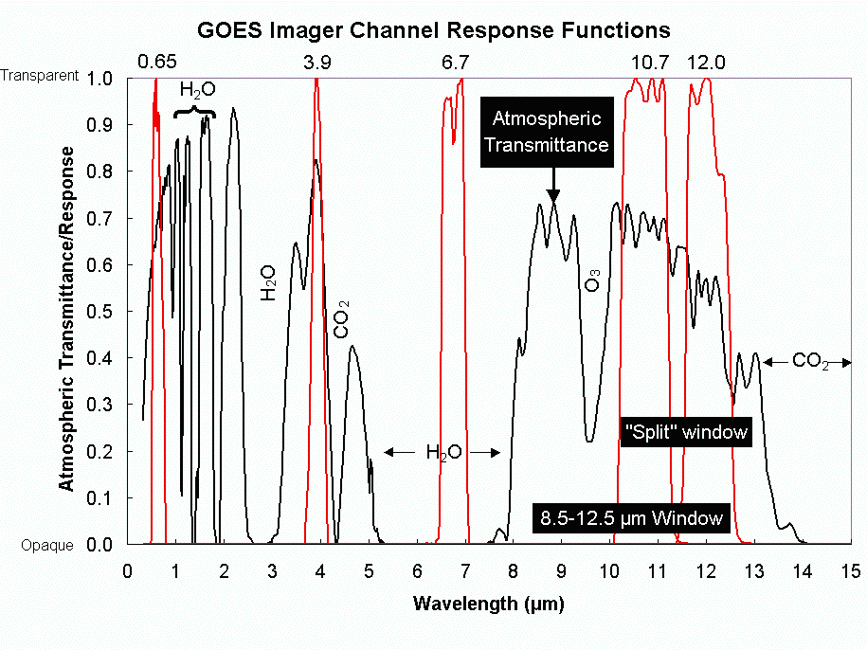
What does τ_{o} look like?
11
Notes:
Black line is tau not for total atm
Red lines are current goes channel response functions
Wider response functions receive more energy – higher signal to noise ratio
Narrow response functions are more sensitive to a particular wavelength
Notice that the trace gasses are doing the absorption – no permanent major gasses

Slide 12
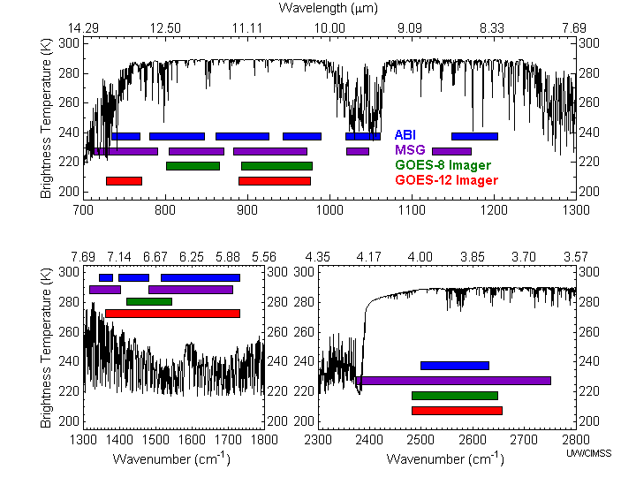
Imagers Compared
Notes:
Schmit, T. J., M. M. Gunshor, W. P. Menzel, J. J. Gurka, J. Li, and A. S. Bachmeier, 2005: Introducing the next-generation Advanced Baseline Imager on GOES-R. Bull. Amer. Meteor. Soc., 86, 1079-1096.
Wavenumber = 1/λαμβδα – προπορτιοναλ το ενεργψ
13 μιχορνσ – χο2 βανδ – υσεδ φορ ηειγητσ οφ χλουδσ

Slide 13
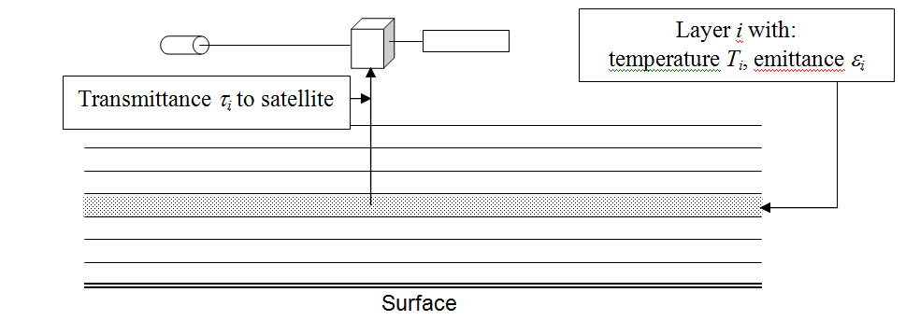
The Atmosphere Emits Radiation Also
If the layer were a black body, it would emit radiance B_{λ}(T_{i}), where T_{i} is the temperature of the layer.
Since the layer is not a perfect blackbody it really emits ε_{i}B_{λ}(T_{i}), where ε_{i} is the emittance (0 ≤ ε_{i} ≤ 1) of the layer.
A fraction of this emitted radiation τ_{i} (0 ≤ τ_{i} ≤ 1) reaches the satellite.
13

Slide 14
The Radiative Transfer Equation
Putting this all together, we can write the radiance that the satellite actually measures
L = ε_{o}B_{λ}(T_{o})τ_{o} + Σε_{i}B_{λ}(T_{i})τ_{i.}
where the first term on the right is the surface contribution, and the second term on the right is the sum of the contributions for all of the atmospheric layers. This equation, usually written as an integral, is the radiative transfer equation.
Surface Term
Atmospheric Term
14

Slide 15
The Weighting Function
At this point, it is customary to define W_{i} as
W_{i} ≡ ε_{i}τ_{i.}
and to call W_{i} the weighting function because it “weights” (multiplies) the blackbody emission B_{λ}(T_{i}) of layer i in the radiative transfer equation. More important than the name, however, is that the weighting function tells us how well the satellite “sees” a particular layer of the atmosphere. It is exactly what we need to know to determine where the radiation that the satellite measures comes from.
15

Slide 16
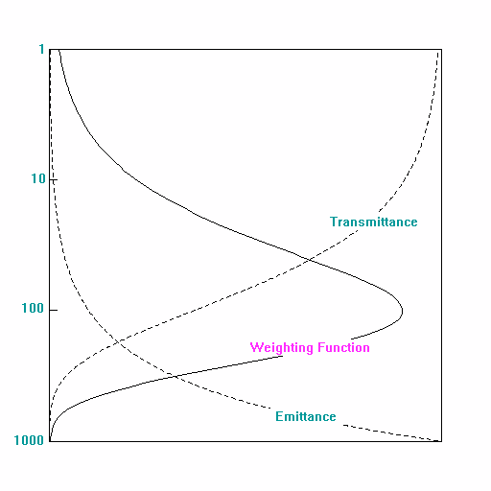
Shape of the Weighting Function
If one chooses height or the logarithm of pressure (which is nearly the same as height) as the vertical coordinate, weighting functions have nearly a Gaussian shape, at least for those channels which do not sense the surface.
16

Slide 17
Shape of the Weighting Function
The transmittance increases with height because at higher altitudes there are fewer absorbing molecules between the layer and the satellite.
The emittance decreases with height because at higher altitudes there are fewer molecules to emit radiation (see below).
17

Slide 18
Shape of the Weighting Function
The product reaches a peak somewhere, though for surface sensing channels, the peak is below the surface. The peak of the weighing function is at the level that is best sensed by the satellite.
18

Slide 19
Shape of the Weighting Function
Above the peak of the weighting function, the satellite doesn't sense the atmosphere as well because there are fewer emitting molecules.
Below the peak, the emitted radiation is mostly absorbed by the atmosphere above.
19

Slide 20
Shape of the Weighting Function
Unfortunately, weighting functions are broad vertically, that is, they sample a thick layer of the atmosphere, which smooths out the fine structure of the vertical temperature (or moisture) profile.
20

Slide 21
The Connection with Absorbing Gas Molecules
Absorbing molecules
The emittance of a layer can be calculated as the product of two things: n_{i}, the number of molecules of absorbing gas per square meter in layer i, and a_{i}, the absorption cross sectional area of each gas molecule, i.e.
ε_{i} = n_{i}a_{i}
Of course, a_{i} is a strong function of wavelength and of the type of gas. In fact, if more than one absorbing gas is present in a layer, than we must add all the contribution of each gas:
Cross section of radiation beam
21

Slide 22
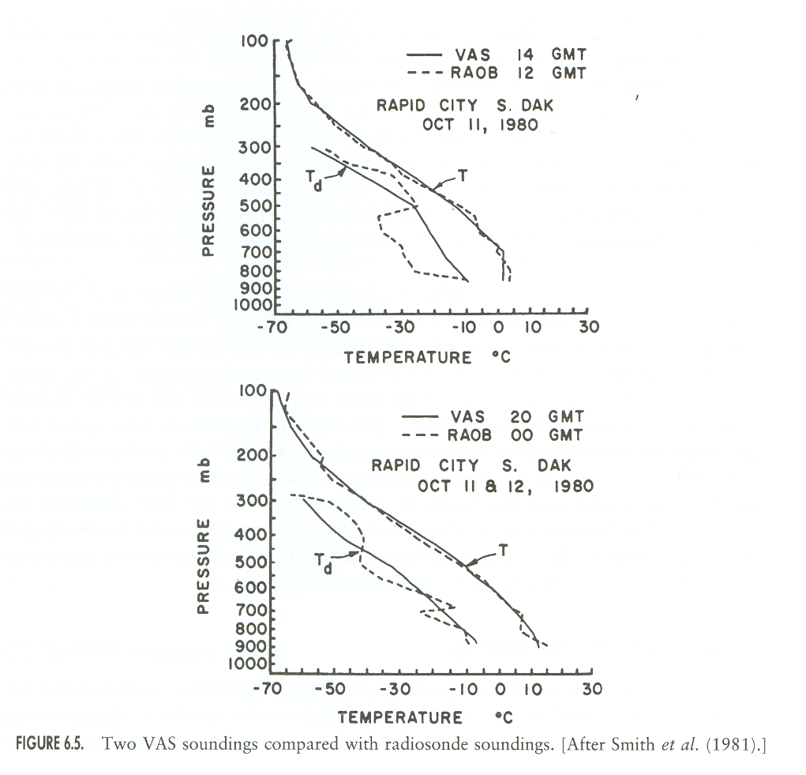
Sounding the Atmosphere
By changing the wavelength, we can move the peak of the weighting function up and down in the atmosphere. By choosing a set of wavelengths which have weighting function peaks that vertically sample the atmosphere, we can get information about the vertical structure of the atmosphere. By inverting the radiative transfer equation, we can retrieve information about this structure. This is known as sounding. One difficulty is that because the weighting functions are broad, fine detail in the vertical temperature structure is lost.
Note that as one changes wavelengths so that the atmosphere is more transparent, the weighting function peak moves down in the atmosphere, but the shape of the weighting function doesn't change. Eventually, the peak of the weighting function would be below the surface. This explains why surface-sensing (window) channels have an exponential shape. In truth, these weighting functions are the same as other weighting functions, but their peak is below the surface.
22
Notes:
Take temps at peak of weighting function

Slide 23
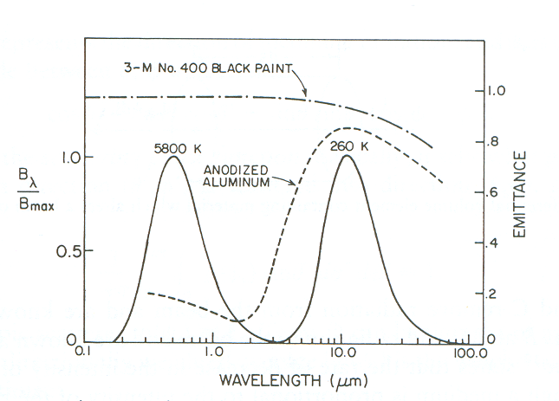
Solar Radiation
Solar radiation is slightly different because neither the Earth nor the atmosphere emit radiation at solar wavelengths
At solar wavelengths, radiative transfer is dominated by reflection (scattering) and absorption.
Solar
Earth
Overlap region
23

Slide 24

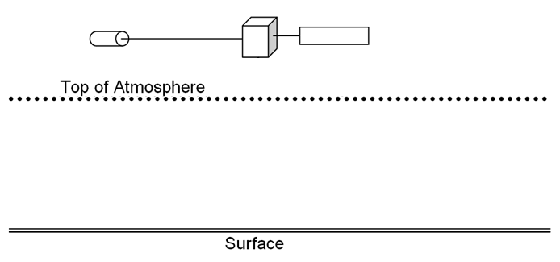
Solar Radiation
τ₁
τ₂
ρ_{surface}
24

Slide 25

Solar Radiation
τ₁
τ₂
ρ_{cloud}
25

Slide 26
Let’s look at some algorithms
Nearly all satellite retrieval algorithms exploit some spectral feature of the atmosphere or surface
The best source of information about an algorithm is the Algorithm Theoretical Basis Document (ATBD).
GOES-R products:
http://www.goes-r.gov/products/list.html
26

Slide 27
Example: Sea Surface Temperature
The 12 μm channel is more affected by water vapor than the 11 μm channel
A quick correction can be found:
SST ≈ T₁₁ + k(T₁₁ – T₁₂)
Often physics is used to justify regression equations or other mathematical techniques, which become the official algorithm (see ATBD)
27

Slide 28
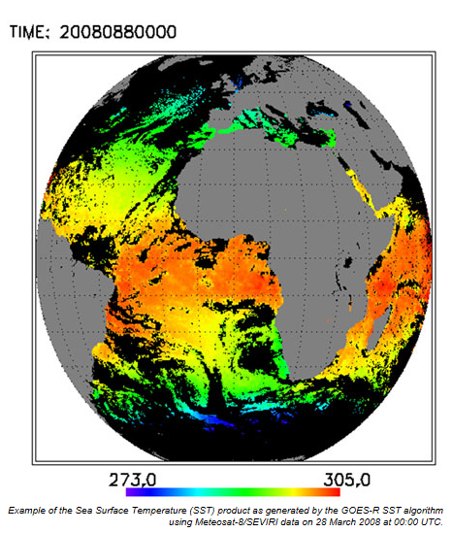
Example: Sea Surface Temperature
28

Slide 29
Example: Cloud-Top Height
The 11.2, 12.3, and 13.3 μm channels are used to nail down the cloud-top temperature, accounting for the emissivity of the cloud and for absorption above the cloud
In a model sounding, the height of the cloud-top temperature is found and used as the height of the cloud top
Z
Z_{c}
T
T_{c}
29

Slide 30
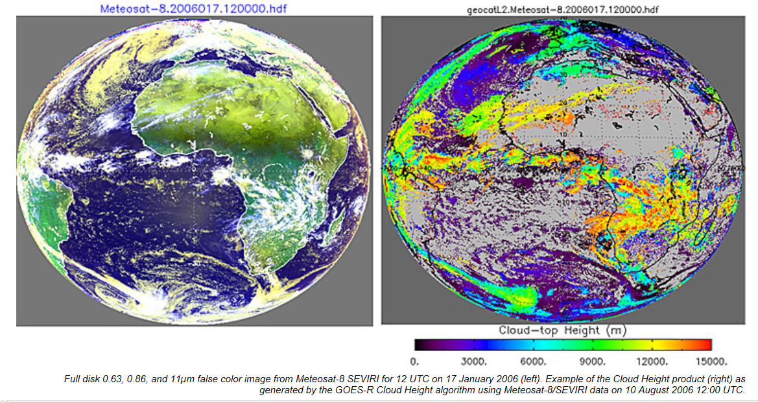
Example: Cloud-Top Height
30

Slide 31
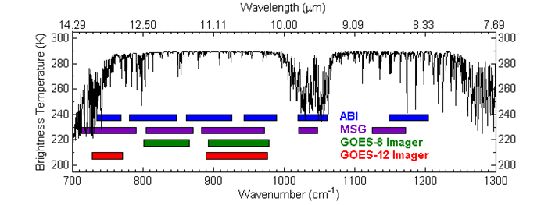
Example: Total Ozone
Uses 6.15, 7.0, 7.4, 9.7, 10.35, 11.2, 12.3, and 13.3 μm and model temperature profiles
The basic idea is that if you know the temperature of the layers where the ozone lives, you can calculate how much ozone is there
31

Slide 32
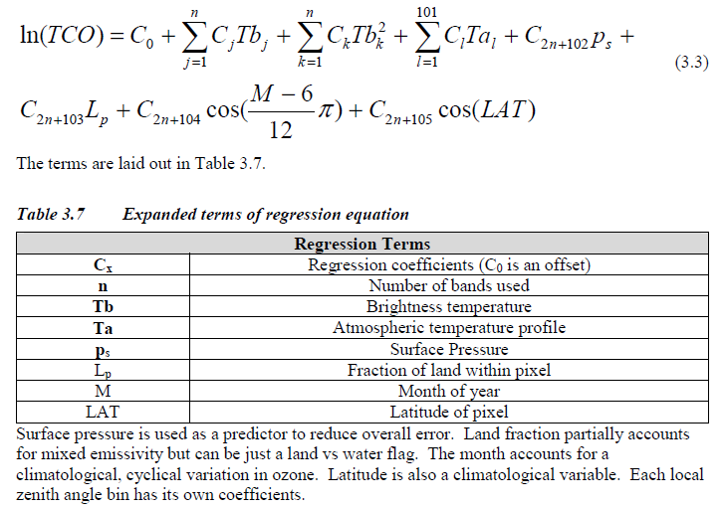
Example: Total Ozone
Uses a regression equation based on a training data set
32

Slide 33
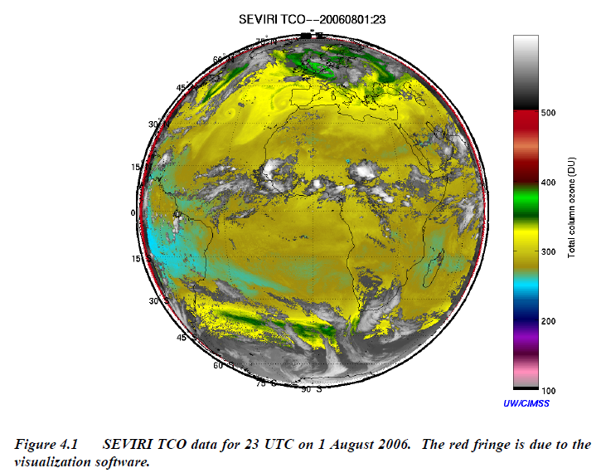
Example: Total Ozone
33

Slide 34
Physics-Assisted Imagery
Forecasters can’t look at an ever-increasing number of channels
Combining channels in clever ways can yield products which are not quite “retrievals,” but which provide useful physical information in a “compact” format
Example from yesterday’s lecture:
http://products.cira.colostate.edu/MSG
VIS/SW/IR RGB imagery:
http://rammb.cira.colostate.edu/ramsdis/online/goes-west_goes-east.asp
Tropical imagery example:
http://products.cira.colostate.edu/GOES-SA/goes.htm
34

Slide 35
Blended Products
No one observing system provides all the data that forecasters need
Combining data from different systems can yield a more complete view
Examples
  Blended TPW and Blended Rain Rate:
  http://cat.cira.colostate.edu
  Experimental Blended TPW:
  http://cat.cira.colostate.edu/bTPW
35

