Slide 1
Supercell Physical Processes
Updraft Tilt
Mid-level rotation
Straight hodograph processes
Curved hodograph processes
Low-level rotation

Slide 2
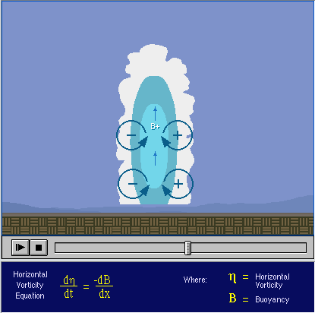
Updraft Tilt
In an environment with no vertical wind shear, there is no tilt to the updraft.
This can also be explained from a vorticity perspective
In this case, the cell will not live long since the downdraft will cut off the updraft.

Slide 3
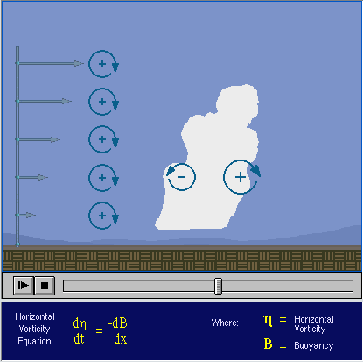
Updraft Tilt
In an environment with deep vertical wind shear, the updraft will tilt over
This tilt can also be explained from a vorticity perspective:
Updraft tilt is good for storm longevity since it allows the updraft and downdraft to separate horizontally.

Slide 4
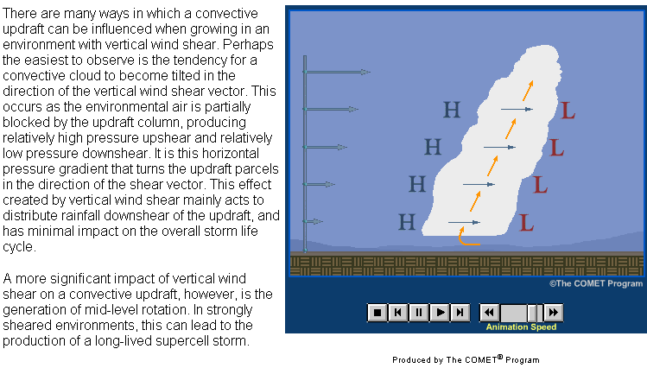
Updraft Tilt
When the updraft interacts with the vertical wind shear, another important effect is to create relatively high pressure upshear of the updraft and low pressure downshear of the updraft.
We’ll come back to this point later.
Shear vector

Slide 5
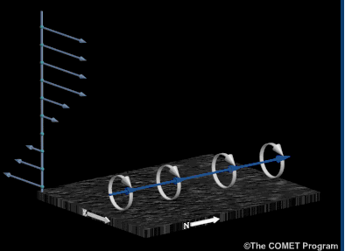
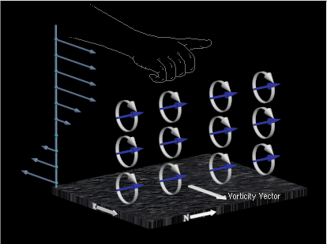
Mid-level rotation
(mesocyclone)
Take the simple case of deep westerly shear
The shear vector is westerly
This creates horizontal vorticity
The horizontal vorticity vectors are oriented to the north (right hand rule)
lines connecting the vorticity vectors are called vortex lines.
Thus, a vortex line is essentially a streamline for the vorticity field.
Vortex line:

Slide 6
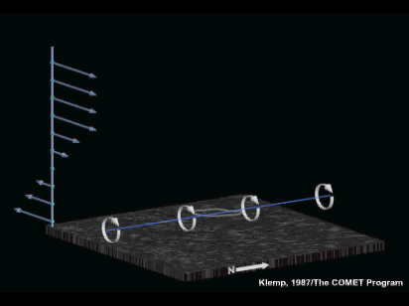
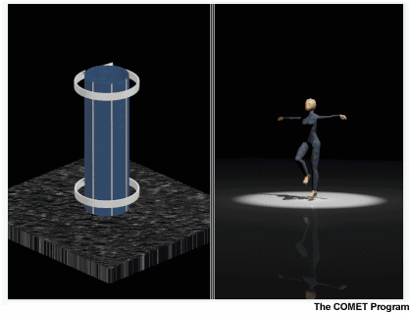
Mid-level rotation (mesocyclone)
So, how is the mid-level rotation, or mesocyclone created in a supercell?
The mesocyclone is rotation about a vertical axis and therefore contains vertical vorticity.
Consider the vertical vorticity equation:
The first term on the rhs represents the tilting process while the second term represents stretching

Slide 7
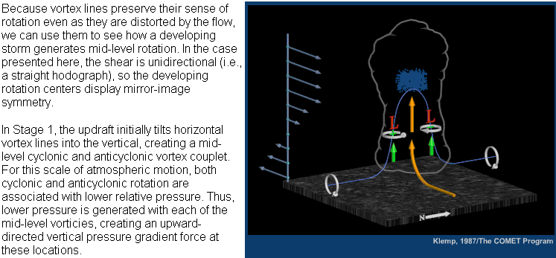
Mid-level rotation (mesocyclone)
Note that both the counterclockwise and clockwise mid level vertical circulations are associated with low pressure.
These mid level low pressure areas help to create upward vertical accelerations, as can be shown with the vertical equation of motion:

Slide 8
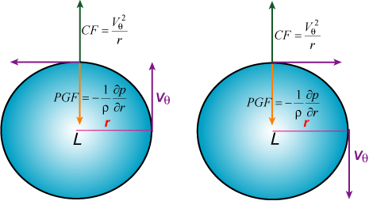
Mid-level rotation (mesocyclone)
Both circulations are associated with low pressure at the center as they are in cyclostrophic wind balance:

Slide 9
Storm Splitting
After the updraft has tilted horizontal vortex lines into the vertical creating the mesocyclone pair, the downdraft will then split the storm in two:

Slide 10
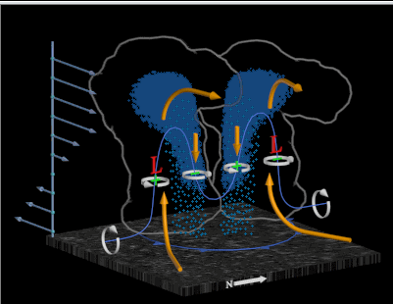
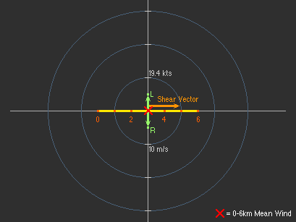
Storm Motion
For the situation when you have a straight hodograph exhibiting westerly shear:
The southern-most storm will exhibit deviant motion to the south
This is where the updraft will continuously tilt vortex lines vertically, maintaining mesocyclone generation
The southernmost supercell will propagate 3-8 m/s to the south of the 0-6 km mean wind.
This is also to the right of the 0-6 km shear vector
The northern supercell will propagate 3-8 m/s to the left of the 0-6 km shear vector.

Slide 11
Storm Motion
Remember the H-L couplet created as the updraft interacts with the vertical wind shear:
Does this H-L couplet in any way affect supercell motion or evolution?????
Shear vector

Slide 12
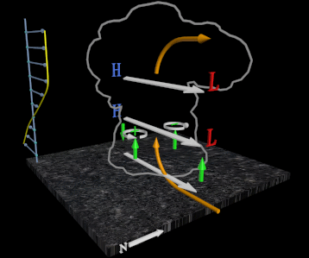
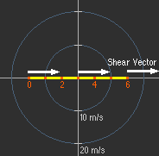
Storm Motion
Does this H-L couplet in any way affect supercell motion or evolution?????
If the hodograph is straight, NO
Left mover
Right mover

Slide 13
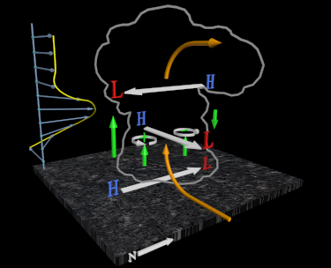
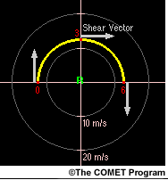
Storm Motion
Does this H-L couplet in any way affect supercell motion or evolution?????
If the hodograph is curved, yes!!!
While buoyancy contributes to updraft strength, the vertical pressure patterns illustrated below are largely responsible for the supercell updraft and in the case below, why it preferentially forms on the southern flank of the storm
For CCW curvature in the hodograph, the left mover would be enhanced, the right mover suppressed.
Left mover is suppressed
Right mover is enhanced

Slide 14
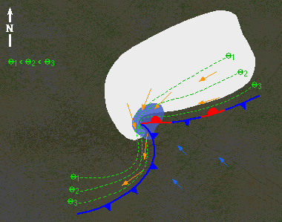
Low-level mesocyclone
In supercells, a separate low-level (0-3 km AGL) mesocyclone develops independently from the mid-level (3-7 km AGL) mesocyclone previously discussed.
Consider the following schematic of a supercell at low levels:
Primary updraft
Horizontal vorticity vectors

Slide 15
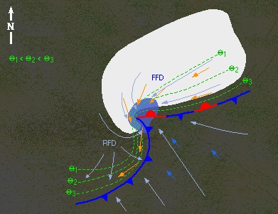
Low-level mesocyclone
Notice that along the FFD, air parcels move parallel to the gust front and horizontal vorticity vectors. They therefore acquire streamwise vorticity that is then tilted upward by the storms updraft producing the low-level mesocyclone
What is streamwise vorticity, youask?
Parcels moving along the FF gust front acquire “streamwise” horizontal vorticity
Primary updraft
Horizontal vorticity vectors

Slide 16
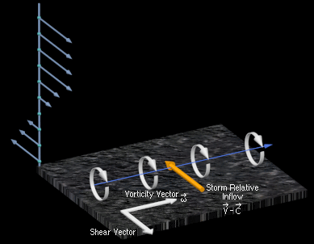
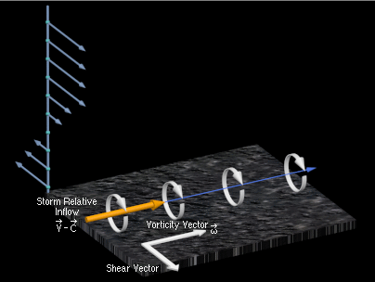
Streamwise and Crosswise vorticity
Streamwise vorticty – if the storm relative winds are in the same direction as the horizontal vorticity vector, then the air parcels have streamwise horizontal vorticity – like a well-thrown football
Also:
And is in fact, a maximum in the picture below
Crosswise vorticty – if the storm relative winds are perpendicular to the vorticity vector, then crosswise horizontal vorticity exists as in the picture below:
Also:

Slide 17
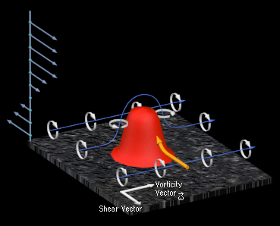
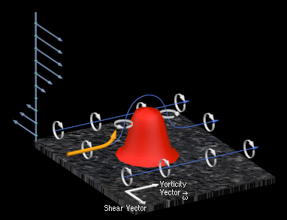
Tilting Streamwise and crosswise vorticity by and updraft
If an updraft tilts air parcels with streamwise vorticity, they immediately acquire vertical vorticity since the updraft and vertical vorticity fields are spatially, positively correlated.
If an updraft tilts air parcels with crosswise vorticity, the updraft is not spatially correlated with the vertical vorticity field and therefore, does not immediately acquire rotation

Slide 18
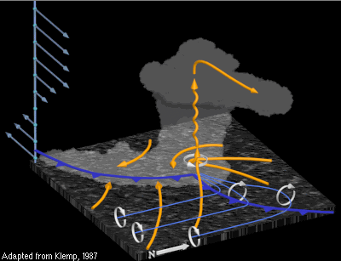
Back to the low level mesocyclone
As the parcels of air (yellow ribbons in the diagram below) move along the FF gust front, they acquire streamwise vorticity since they are moving parallel to the horizontal vorticity vectors (or vortex lines shown as blue lines in the diagram below) created by the buoyancy gradient at the gust front.
These parcels are then tilted by the storms updraft, creating a low-level cyclonic vortex.
This has been our conceptual model of low level mesocyclogenesis since the mid 80’s…….

Slide 19
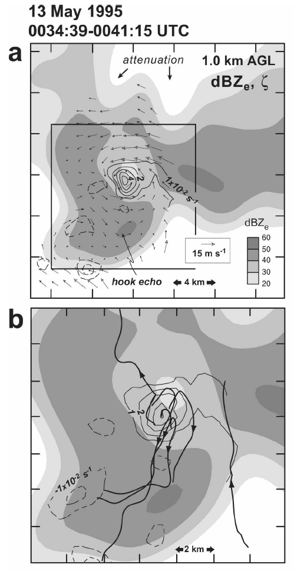
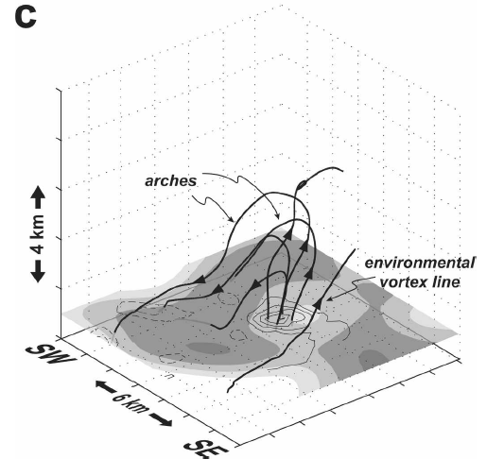
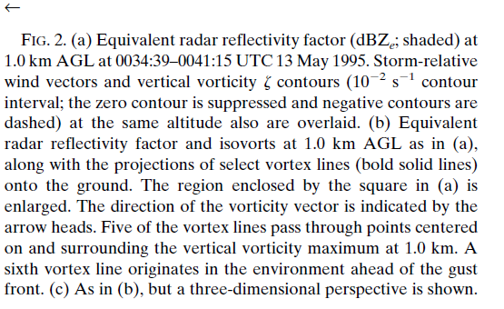
Another perspective.
mesocyclone
Markowski et al. 2008 - MWR

Slide 20
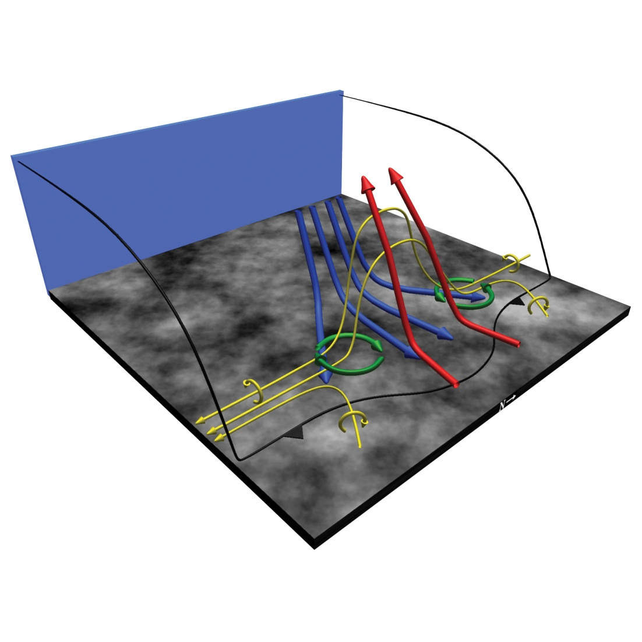
Markowski et al. 2008 - MWR
It’s the baroclinic generation along the RFD that generates the horizontal vorticity that is tilted in a cross-wise sense by the updraft.
The hook and RFD straddles the couplet.
This process is observed in other atmospheric phenomena:
Atkins and St. Laurent (2008b) - MWR

